Slide 1
COMMON ERRORS
By
Dr. Aref Shaikh
Assistant Professor
G.K Joshi (Night) Commerce College, Latur

Slide 2
There is nothing like ‘Correct English’……….
G.B. Shaw
“Spoken English and Broken English”

Slide 3
According to 2001 data, India has the second highest number of English speakers.
It is a second language for a vast majority of people. In a country where many regional languages are used, a lot of errors creep into the grammar and vocabulary of an average English speaker in India.
Writing and speaking in English as a non-native speaker has its own set of problems.
Grammatical errors come in many forms and can easily confuse and obscure meaning.

Slide 4
Banking – IBPS / SBI BANK
INSURANCE – LIC / GENERAL INSURANCE
RAILWAY – NTPC /GROUP D / LOCO PILOT
SSC – CHSL / CGL / MULTITASKING
MBA – CAT / CET / CMAT

Slide 5
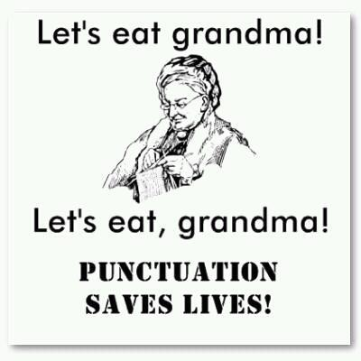
The Purpose of Grammar
Common Errors
Clarity of meaning
Readability
Credibility

Slide 7
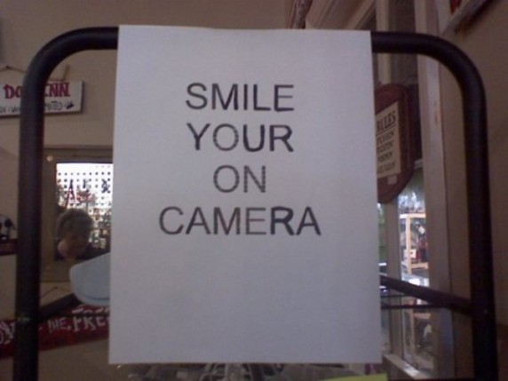

Slide 8
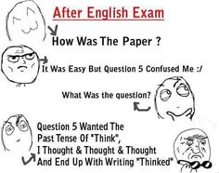

Slide 10
Agreement of the verb with the subject……
A verb must agree with its subject in number and person.
When the subject is singular, the verb must be singular.
When the subject is plural verb must be plural.
Ex- The student are very talented. (Incorrect)
The student is very talented. (Correct)

Slide 11
When the subject consists of two or more nouns and joined by “and” then the verb must be plural.
Ex- Annie and her brothers was at school. (Incorrect)
Annie and her brothers were at school. (Correct)
If two nouns are joined by “and” and expressed one idea, the verb must be in singular form.
Ex- Early to bed and early to rise make a man healthy. (Incorrect)
Early to bed and early to rise makes a man healthy. (Correct)
Brad and butter, Slow and steady etc.

Slide 12
Tourism have been considered one of the most important factors in the economical development of a country.

Slide 13
Countable nouns - 1 2 3 4 5 6 7 8 9 10…….

Slide 14
Uncountable nouns -

Slide 16
One of my friends like to cook Italian food. (Incorrect)
Knowledge has create the opportunities for the development of multiple vaccines. (Incorrect)
I might gone to the park after school today. (Incorrect)

Slide 17
When the subject is third person singular, the verb must carry –s or –es suffix
S + M.V. (I) + Object
Emma watches cartoons every day.

Slide 18
To have + M.V (III)
Venu and Parvati have invited all their friends for today’s party.

Slide 19
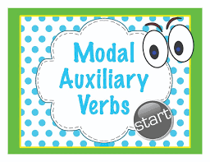
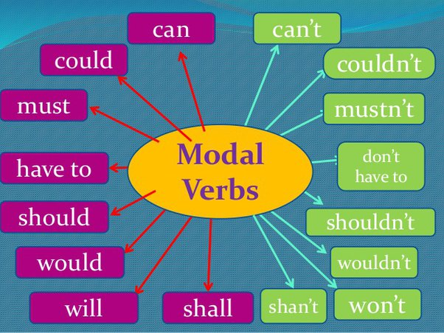

Slide 20
Gender
Number

Slide 23
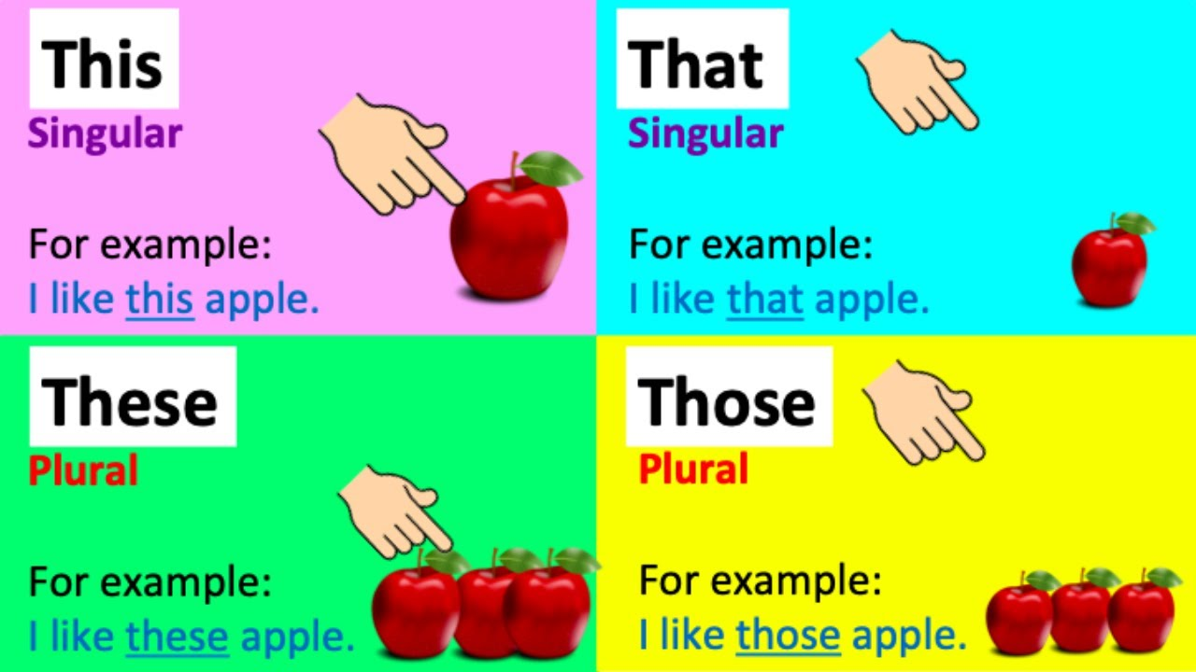

Slide 24
An investigating officer submitted his report. (Incorrect)
Isabel and Barbara love her children. (Incorrect)
If the teacher is good (a) / the students will respond (b) / positively to them (c) / No error (d)
This is my brother which is a teacher.

Slide 25
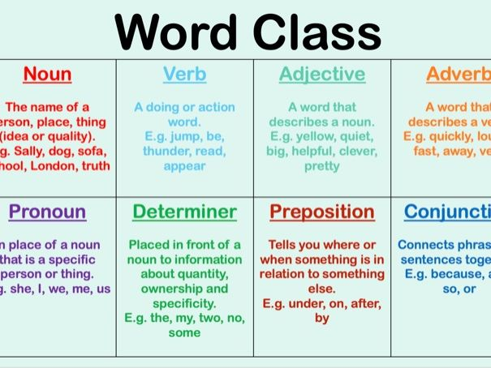

Slide 26
Check the arrangements of the words in the sentence
Adjective + Noun
Adverb + Verb
Adverb + Adjective + Noun

Slide 28
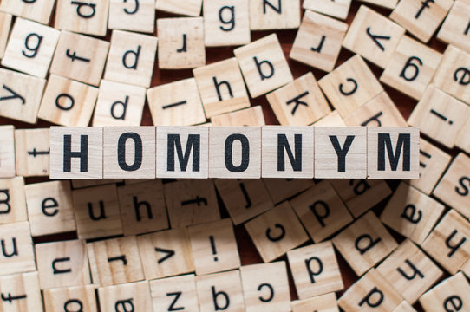

Slide 29
A word that is spelt and pronounced like another word but that has a different meaning.
Principal – a person who’s in charge of certain things in a company.
Principle - a rule, a law, a guideline, or a fact.
Stationary – fixed, unchanging
Stationery - refers to paper, matching envelopes, and writing implements.

