Slide 1
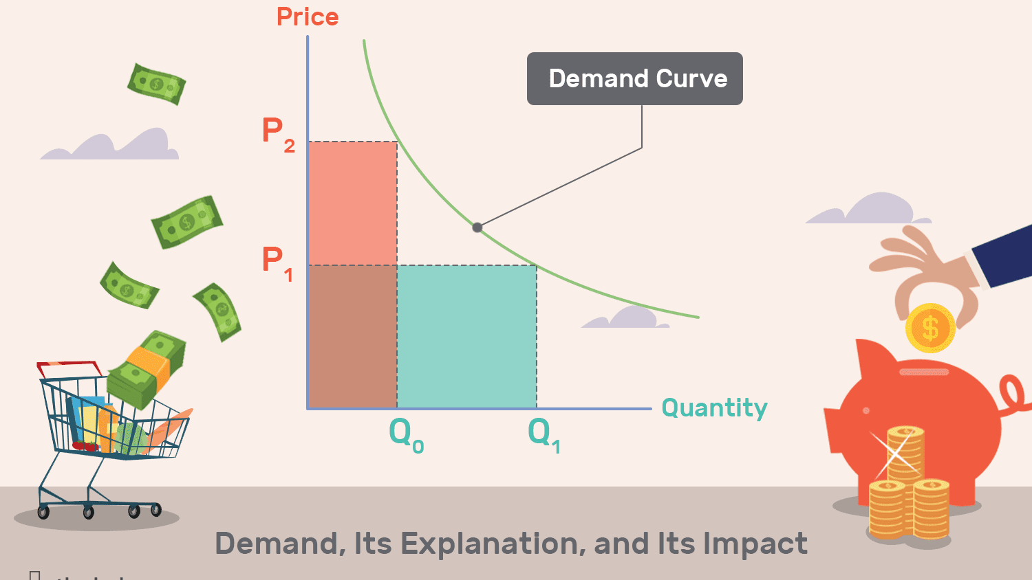
Business Eco- Demand Analysis
Meaning
Definition
Individual and Market Demand Schedule-Tabular and Graphical
Types of demand
Determinants
Law of Demand
Assumption
Exceptions
Changes
in demand

Slide 2
Major Point of Confusion
Concept of Demand
Desire + Ability to pay
+ Willing to pay
Law of Demand
High price low demand
Low price high demand
Elasticity of Demand
How much demand is changed
Due to how much change in price

Slide 3
Meaning & Definition of Demand….
Demand means desire to have something backed by willingness and ability to pay.
Just desire has no meaning
Only willingness is not sufficient
Having ability to pay is not only factor
Combination of these three is needed.
Demand (in economy) = Desire + Willingness to buy + Ability to pay.

Slide 4
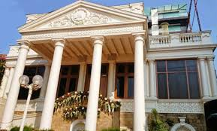
Meaning & Definition of Demand
‘Demand is a consumers’ desire to purchase goods and service and willing to pay price for specific goods holding all other factors constant.’ – Investopedia

Slide 5
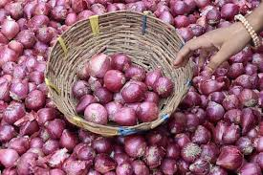
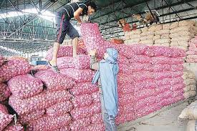
Individual and Market Demand
Price in Rs. | Individual Demand (in Units) |  |  | Market Demand
 | Consumer A | Consumer B | Consumer C | A+B+C
20 | 05 | 10 | 15 | 30
16 | 10 | 15 | 20 | 45
12 | 15 | 20 | 25 | 60
8 | 20 | 25 | 30 | 75
4 | 25 | 30 | 35 | 90

Slide 6
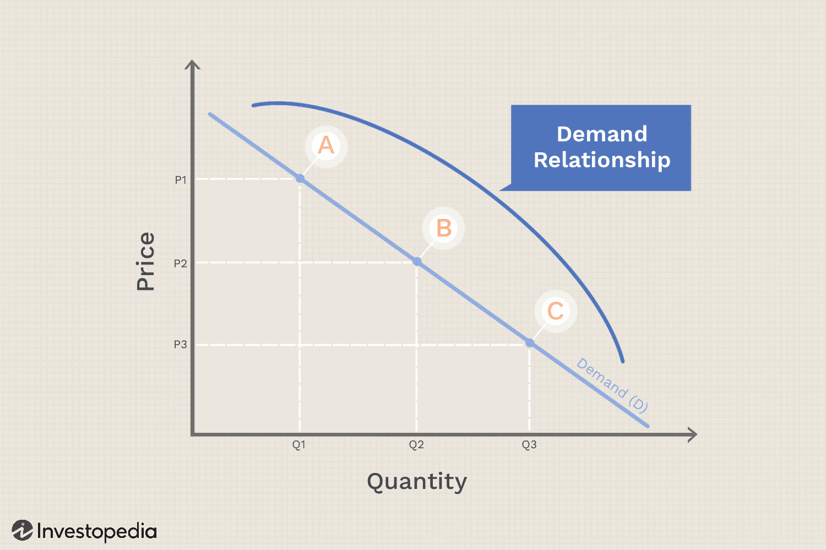
Reasons for downward sloping Demand Curve …

Slide 7
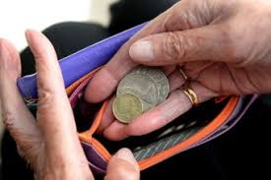
Reasons for downward sloping Demand Curve
1.Law of Diminishing marginal Utility
2. Income Effect

Slide 8
Reasons for downward sloping Demand Curve
3.Substitution Effect:-
4. Multipurpose Use :-

Slide 9
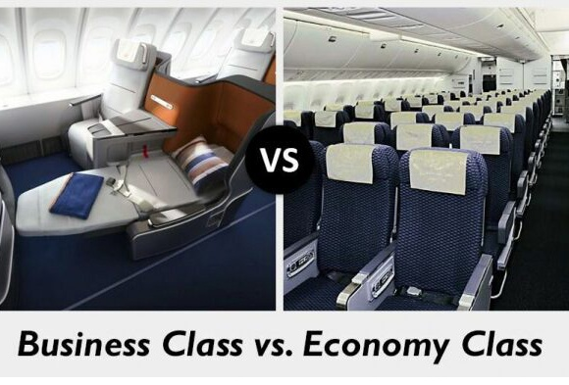
Reasons for downward sloping Demand Curve
5. New Consumers :-

Slide 10
Types of Demand
1.
Direct Demand
2.
Indirect/Derived Demand
3.
Joint Demand
4.
Composite Demand
5.
Competitive Demand

Slide 11
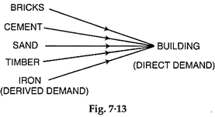
Types of Demand -1&2- Direct and Derived Demand

Slide 12
Types of Demand – 3. Complementary /Joint Demand

Slide 13
Types of Demand – 4. Composite Demand

Slide 14
Types of Demand – 5. Competitive Demand

Slide 15
Drop your suggestions at - sachinprayag1@gmail.com OR Contact- 9881717278
Dr. Sachin M. Prayag.
Assistant Professor.
Department of Commerce,
Govindlal Kanhaiyalal Joshi (Night) Commerce College, Latur.
Thank You !!!

